Slide 1
Sequence
Notes:
Purpose
To introduce the basics of coding in Code Disco.
Learning objective
By the end of this tutorial children should be able to:
Understand that programs consist of instructions that are executed in order, one by one
Make simple programs

Slide 2
Algorithm
Sequence
Sprite
Notes:
Introduce students to key vocabulary for this lesson:
Algorithm: An unambiguous procedure or precise step-by-step guide to solve a problem or achieve a particular objective.
Sequence: “When we sequence things, we arrange them in a particular order. Sequence-based algorithms are made from a precise set of instructions.”
Sprite: These are the images that perform actions in a visual program. Examples are the penguin, rocket etc. Note however, that the backgrounds are also sprites.

Slide 3
A sequence is when we arrange something in a particular order. Sequence-based algorithms are made from a precise set of instructions.
Notes:
Explain to students about the importance of sequence in computing/coding.
In sequence-based algorithms, such as a recipe to bake a cake, the order of many (though not all) of the steps is crucial. Similarly, most programming languages are based on a series of statements to sequentially process. The outcome of a program will depend not only on the constituent commands but their order.

Slide 4
Notes:
Introduce Code Disco:
Children should be encouraged to try running their programs to see what happens. They should not always expect to get it right first time. Testing a program, seeing what goes wrong and then fixing the problem is a very important part of coding (debugging). Tutorials and challenges in Code Disco always build on what has been learned previously. Children should be encouraged to think about what they've just learned, and see how it can be adapted and extended to solve other problems. Breaking a problem down into simpler problems and then combining the solutions is a very useful strategy in coding.

Slide 5
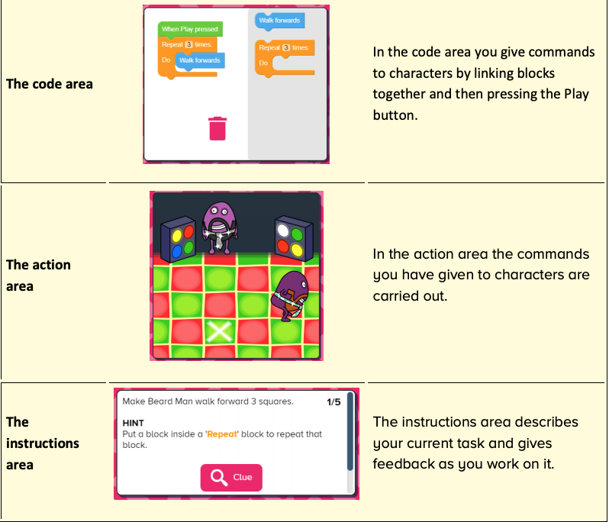
Notes:
Introduce students to Busy Code:
code area
action area
instructions area

Slide 6
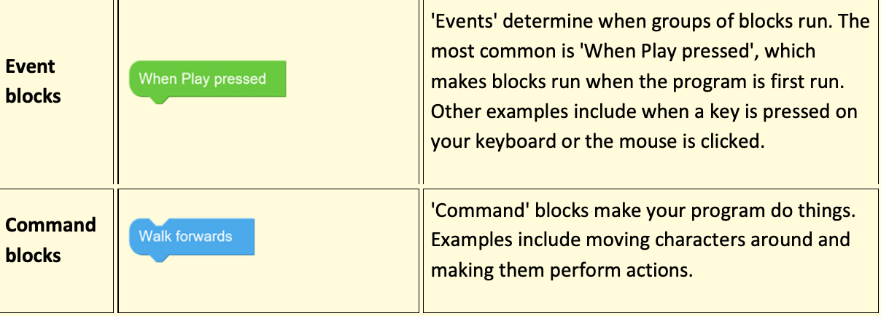
Notes:
Introduce students to Busy Code:
code area
action area
instructions area

Slide 7
Notes:
Tutorials consist of multiple steps that can be worked through.
The objective will be presented in the instructions area in the bottom left of the screen, along with any hints that may help children to complete the stage. Some steps include a clue button which will give a visual clue, normally where a new block type is introduced, or an existing block type is used in a new way.
Once each stage is complete, a next button will appear allowing children to move onto the next stage.
Once the final stage has been completed, children can either try any related challenges or projects or can move onto the next tutorial.
You will want to demo this with your students going thought the first instructions together.

Slide 8
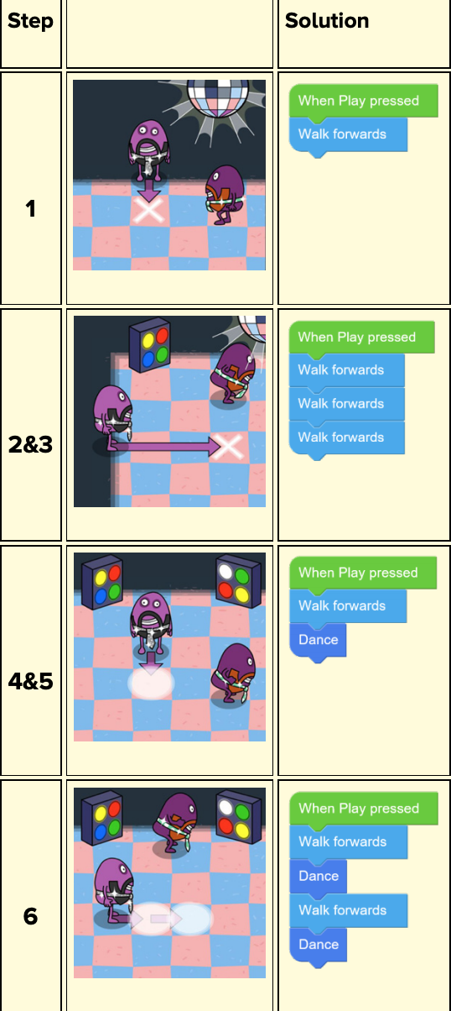
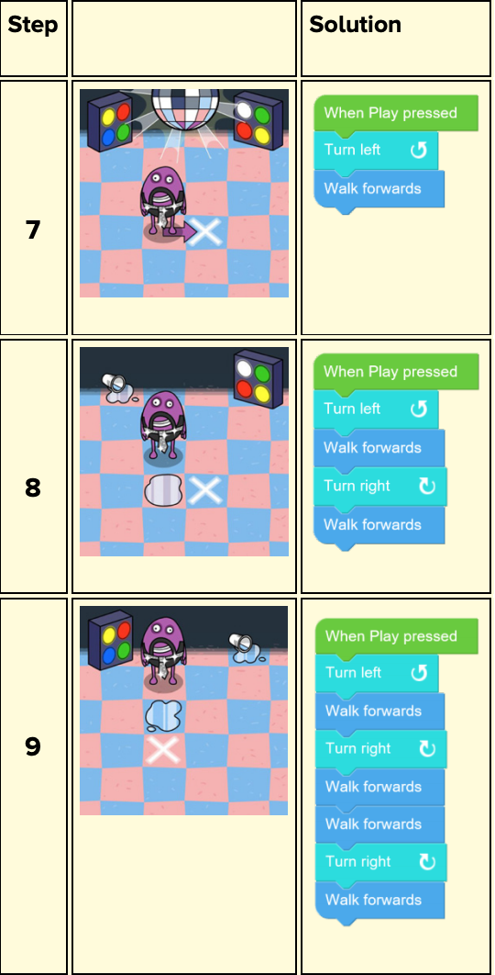
Notes:
Tutorials consist of multiple steps that can be worked through.
The objective will be presented in the instructions area in the bottom left of the screen, along with any hints that may help children to complete the stage. Some steps include a clue button which will give a visual clue, normally where a new block type is introduced, or an existing block type is used in a new way.
Once each stage is complete, a next button will appear allowing children to move onto the next stage.
Once the final stage has been completed, children can either try any related challenges or projects or can move onto the next tutorial.
You will want to demo this with your students going thought the first instructions together.

Slide 9
Notes:
Objective:
Use what you've learned in Tutorial 1 to try and complete the challenge, using no more than the number of blocks suggested. Challenge resources work in a similar manner to tutorial resources, but the problems are harder to solve. They are intended to test that children have grasped the concepts introduced in the preceding tutorials. Each task in a challenge has a suggested block limit the children should try to stay within.

Slide 10
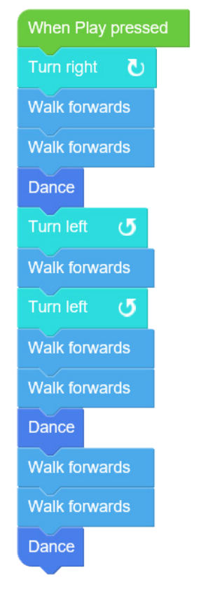
Notes:
Objective
Use what you've learned in Tutorial 1 to try and complete the challenge, using no more than the number of blocks suggested. Challenge resources work in a similar manner to tutorial resources, but the problems are harder to solve. They are intended to test that children have grasped the concepts introduced in the preceding tutorials. Each task in a challenge has a suggested block limit the children should try to stay within.

Slide 11
Notes:
Project: Dancing 1
Objective:
Create a synchronised dance routine for two characters. The project starts with two characters on screen. Each character has their own set of blocks. Click on a character to see that character's blocks. Characters can be moved by dragging them around.
Project resources are open-ended tasks that give children the chance to be creative with what they have learned so far. Each project is concentrated on a specific theme and only provides the relevant blocks/characters/props to work within that theme. There are no correct answers and children should be encouraged to experiment. Projects are often provided in multiple versions, so children can revisit a similar idea once they have learned more and elaborate on their previous ideas. Projects can be saved.
Allow time at the end of the session to share their dances with each other, to do this remind student their need to have named and saved their project.

Slide 12
